Slide 1
Integrated Linux Infrastructure
Ubuntu • LVM • ACL Security • Backup & Recovery • Automation
Enterprise-style departmental storage implementation
Project Presentation | Ubuntu Server in VirtualBox
01

Slide 2
1. Project Overview
What was implemented
Platform
Storage
Protection
Ubuntu Server deployed inside
VirtualBox with an additional 15 GB
storage disk.
LVM-based departmental storage for HR,
IT and Finance using ext4 filesystems.
ACL-based access control plus full,
incremental and automated backup
workflows.
Designed a structured storage layout instead of relying on a single filesystem.
Separated departmental data to support controlled access and independent capacity management.
Demonstrated recovery and later expanded the HR logical volume by 1 GB.
02

Slide 3
2. Problem Statement
Why a structured departmental Linux infrastructure was needed
Storage was difficult to manage
Departmental data needed protection
A single shared storage area makes departmental capacity harder to allocate, monitor and expand.
HR, IT and Finance require separate mount points and controlled access to reduce accidental or unauthorized access.
Data loss and recovery risk
Manual operations are repetitive
Without tested backups, deleted or changed files may be difficult to restore reliably.
Repeated backup tasks can be inconsistent when they are not standardized or automated.
Project challenge: build a manageable, access-controlled and recoverable storage environment on Ubuntu Server.
03

Slide 4
3. Objectives
Infrastructure goals achieved
01 Provision storage
02 Department separation
Partition the additional disk and build the LVM hierarchy.
Create dedicated HR, IT and Finance logical volumes.
03 Secure access
04 Protect data
Apply ACLs and verify authorized departmental access.
Create backups, restore data and validate recovery.
05 Automate
06 Scale
Use a Bash backup script for repeatable backup operations.
Demonstrate online capacity expansion for HR.
04

Slide 5
4. Proposed Solution
How the project addresses the identified problems
1 Flexible storage
2 Access control
3 Backup & recovery
Use LVM on the additional disk to create separate logical volumes for HR, IT and Finance.
Use filesystem permissions and ACLs to grant department-specific access and verify it with getfacl.
Create full and incremental archives, then test recovery by restoring a deleted test file.
4 Automation
5 Scalability
Use a Bash script to generate timestamped compressed backup archives.
Extend the HR logical volume by 1 GB and validate the resulting storage layout.
Outcome: departmental storage with clearer separation, controlled access, backup evidence and room to grow.
05

Slide 6
5. Storage Architecture
From physical disk to departmental mount points
HR LV
hr_lv
/enterprise/hr
15 GB Disk
/dev/sdb
Partition
/dev/sdb1
Volume Group
enterprise_vg
ext4
IT LV
it_lv
/enterprise/it
ext4
Finance LV
finance_lv
/enterprise
/finance
ext4
06

Slide 7
6. LVM Implementation
Logical storage with independent departmental volumes
Physical Volume (PV): /dev/sdb1
Volume Group (VG): enterprise_vg
Logical Volumes: hr_lv, it_lv, finance_lv
Filesystems: ext4
Mount points: /enterprise/hr, /enterprise/it, /enterprise/finance
HR logical volume was later extended by 1 GB using LVM online resize.
Why LVM?
Flexible allocation,
easier resizing and cleaner
separation of departmental storage.
Filesystem
ext4 provides the filesystem layer
on each logical volume.
Validation
LVM and mounted storage were
checked using lvs and df.
07

Slide 8
7. Access Control with ACLs
Departmental authorization and validation
HR
IT
Finance
HR users receive access to
/enterprise/hr while other
departmental access is restricted.
IT storage is separated from HR
and Finance using the same
ACL-based model.
Finance storage remains a
distinct protected departmental area.
ACLs were backed up to /enterprise/acl_backup/department_acls.txt.
ACL restoration was tested successfully.
Authorized HR access was verified by creating a test file as hruser.
The restored test file was removed after validation.
08

Slide 9
6. Backup & Recovery
Multiple recovery layers were demonstrated
FULL BACKUP
INCREMENTAL
RECOVERY
AUTOMATION
Created a compressed
archive of HR, IT and Finance.
Captured a test change
separately from the full backup.
Deleted the test file and
restored it from the incremental
archive.
Bash script generates
timestamped automated
backups.
Backup locations
Recovery evidence
/enterprise/backups/full
/enterprise/backups/incremental
/enterprise/backups/automated
The deleted incremental test file was restored successfully and verified.
09

Slide 10
8. Backup Automation
Repeatable Bash-based operational workflow
#!/bin/bash
BACKUP_DIR="/enterprise/backups/automated"
DATE=$(date +%Y%m%d_%H%M%S)
mkdir -p "$BACKUP_DIR"
tar -czf "$BACKUP_DIR/enterprise_backup_$DATE.tar.gz" ...
echo "Backup completed: ..."
Script
/enterprise/scripts/backup.sh
Output
Timestamped .tar.gz archives
in the automated backup directory.
Validation
Script execution and backup
directory listing were tested.
10

Slide 11
9. Capacity Expansion
Demonstrating LVM scalability
Before
Change
After
HR logical volume had its
original allocation and the
volume group still contained free space.
HR was extended by +1 GB using
lvextend with filesystem resize enabled.
LVM/storage validation was
performed to confirm the expanded layout.
Key benefit: capacity can be increased without rebuilding the department filesystem from scratch.
This demonstrates practical storage administration rather than only initial provisioning.
11

Slide 12
10. Validation & Evidence
Checks used to confirm the implementation
LVM
sudo lvs — Logical volumes and sizing
Mounts
df -h | grep /enterprise — Department filesystems
ACL
getfacl /enterprise/hr — hruser permission evidence
Backups
ls -lh /enterprise/backups/... — Backup artifacts
Automation
ls -l /enterprise/scripts/backup.sh — Executable script
12

Slide 13
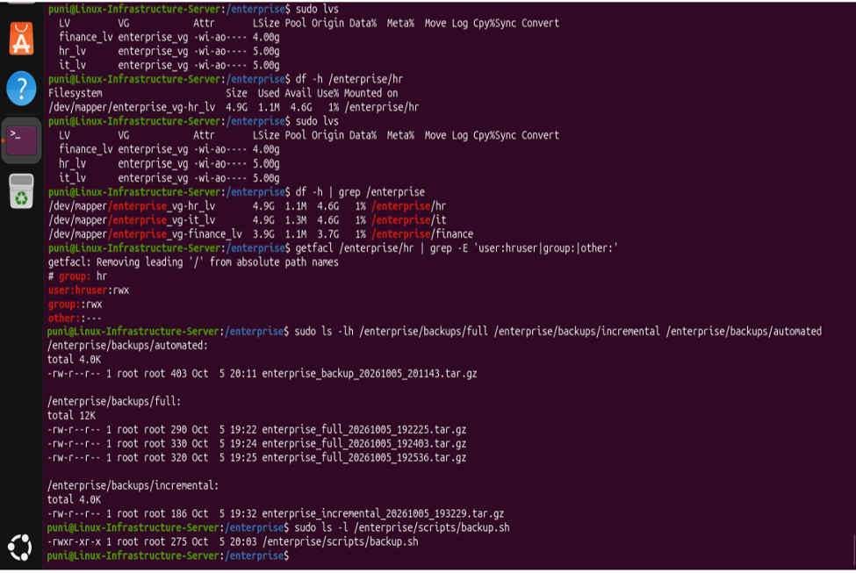
11. Evidence — Storage, ACL & Backup Files
Terminal validation captured from the Ubuntu project environment
Visible evidence: LVM logical volumes, mounted departmental filesystems, HR ACL output, backup archives and executable backup script.
13

Slide 14
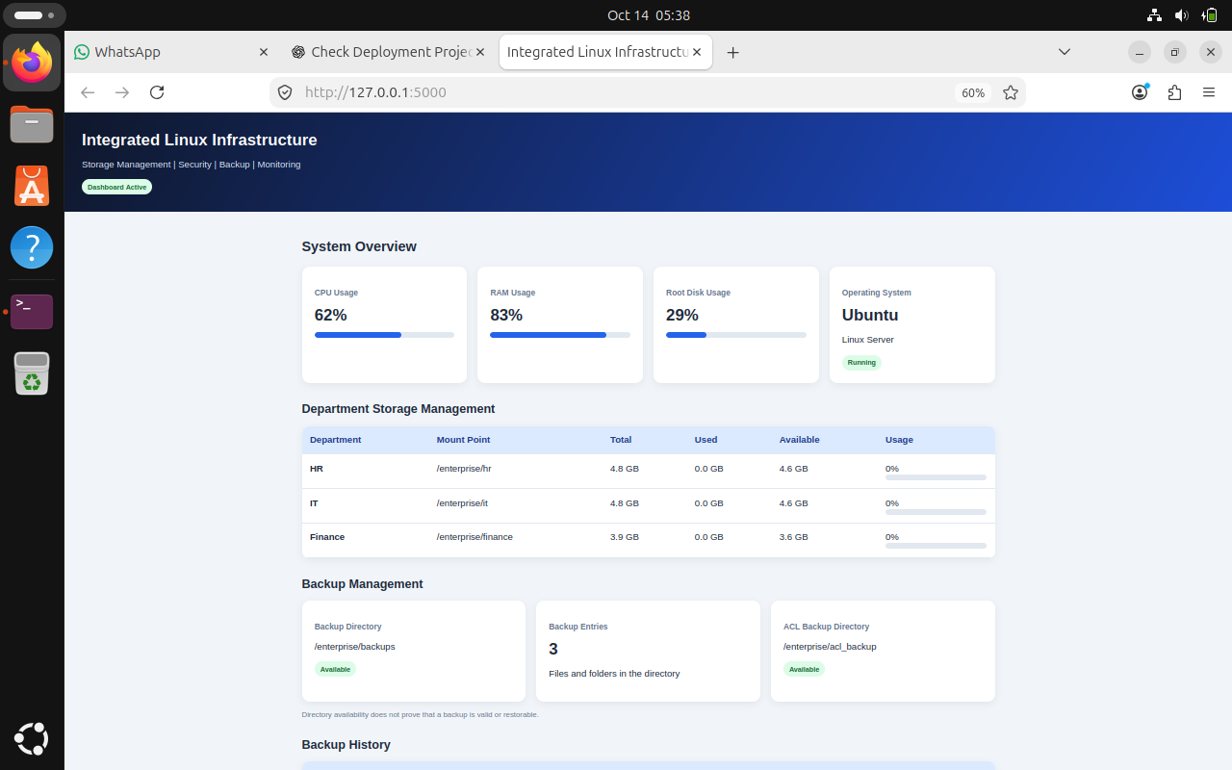
12. Evidence — Infrastructure Dashboard
Ubuntu server dashboard showing departmental storage and backup locations
Visible evidence: system overview, HR/IT/Finance mount points, backup directory and ACL backup directory.
14

Slide 15
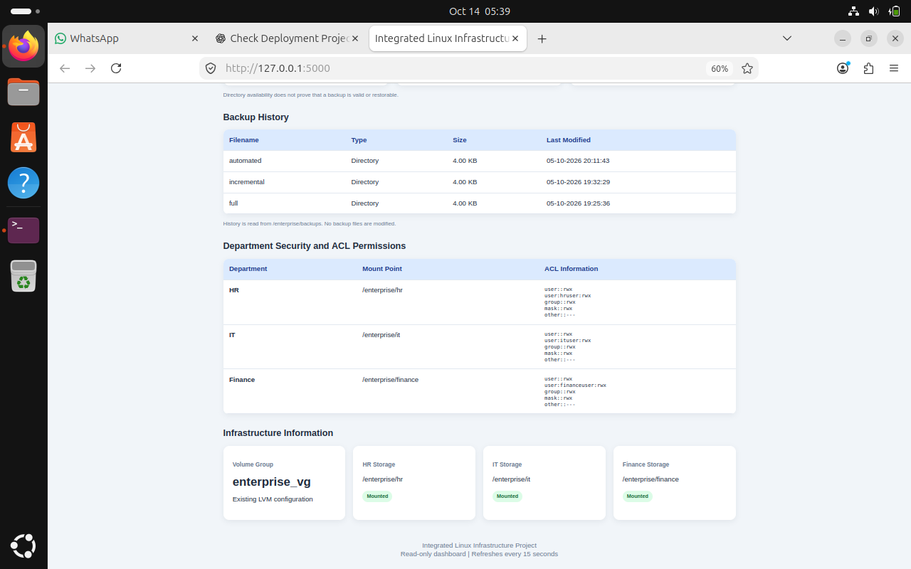
13. Evidence — Backup History & Department Security
Dashboard details for backup folders and department ACL configuration
Visible evidence: full, incremental and automated backup history plus HR, IT and Finance ACL information.
15

Slide 16
14. Final Results
Project outcome
✓ Storage
✓ Security
15 GB additional disk integrated into LVM
ACL-based departmental access implemented and tested
✓ Backup
✓ Recovery
Full and incremental backups created and verified
Deleted test data restored successfully
✓ Automation
✓ Scalability
Bash backup script created and tested
HR logical volume extended by 1 GB
16

Slide 17
15. Conclusion
A practical enterprise-style Linux storage solution
Ubuntu was configured as a structured departmental storage server.
LVM provided flexible storage management for HR, IT and Finance.
ACLs provided controlled access to departmental data.
Backup, recovery and automation improved data protection and operational reliability.
LVM expansion demonstrated that the infrastructure can grow with demand.
Thank you
Questions & Discussion
17

